Slide 1
CAN SOCIAL DATA BE USED FOR PROSPECTING?
Past evidence, and why we need an open research programme

Slide 2
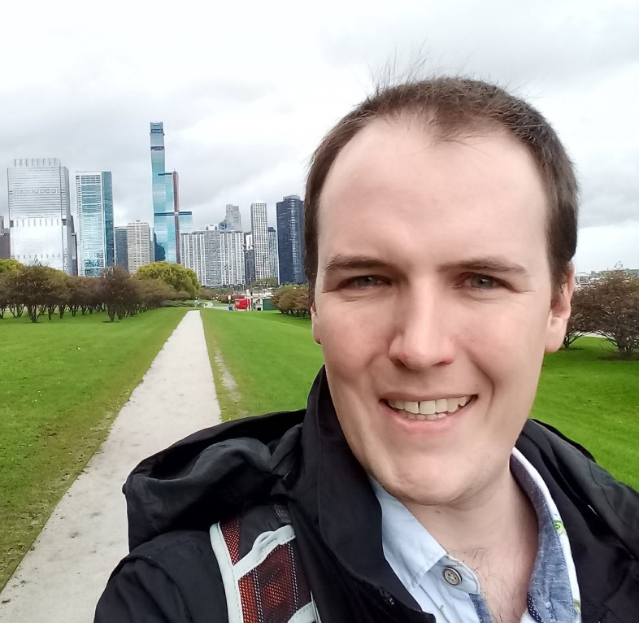
WHO AM I?
Dr. Colin Conrad
Assistant Professor @ Dal School of Information Management (SIM)
Cross-appointed with Psych/Neuro
Research: Enterprise information technology, human-computer interaction, data mining
I like working with organizations on research!
You can find my profile here.
A photo taken in Chicago at the 2019 meeting of the Society for Neuroscience (SFN).

Slide 3
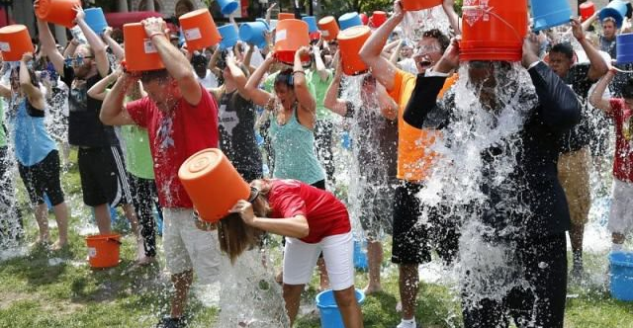
IT’S AN INESCAPABLE FACT…
SOCIAL MEDIA HAS CHANGED CHARITY!
Notes:
Global Panorama (25 August, 2014). Ice bucket challenge. https://www.flickr.com/photos/121483302@N02/15038945225

Slide 4
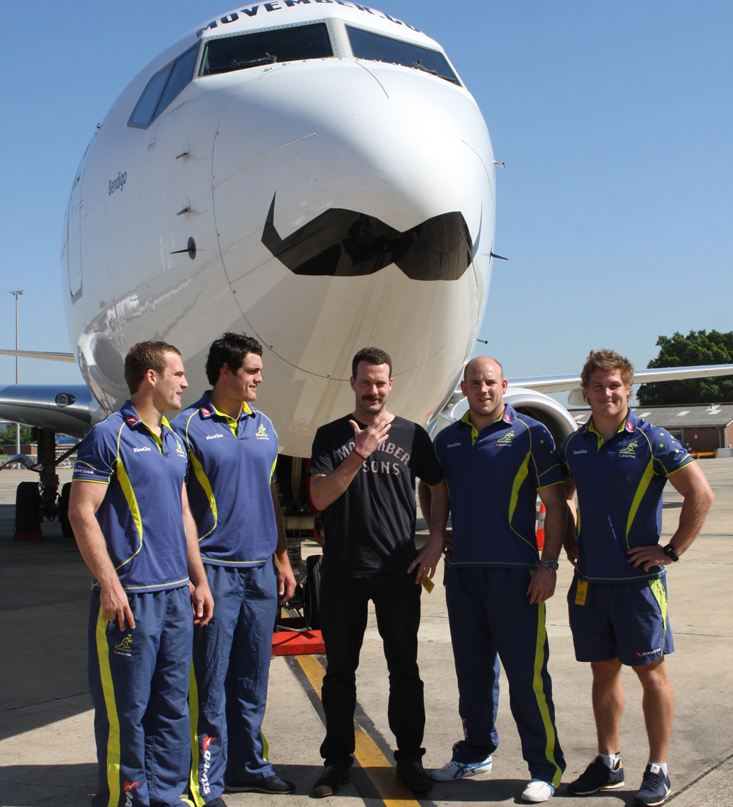
WHY SHOULD WE CARE ABOUT SOCIAL DATA?
Social media are technologies that facilitate exchange through virtual communities.¹
They facilitate a network effect that can amplify messages beyond traditional media.²
On social media, people:
Express activities, interests & opinions³
Develop networks of similar people.^{1,3}
Generate copious amounts of data! Wait…
Notes:
Kietzmann, J. H., Hermkens, K., McCarthy, I. P., & Silvestre, B. S. (2011). Social media? Get serious! Understanding the functional building blocks of social media. Business horizons, 54(3), 241-251.
Fulgoni, G. M., & Lipsman, A. (2015). Digital word of mouth and its offline amplification: A holistic approach to leveraging and amplifying all forms of WOM. Journal of advertising research, 55(1), 18-21.
Conrad, C. (2015). Predicting Political Donations Using Data Driven Lifestyle Profiles Generated from Character N-Gram Analysis of Heterogeneous Online Sources (Masters dissertation).
Movember (31 October, 2012). https://commons.wikimedia.org/wiki/File:Movember_(8140156949).jpg

Slide 5
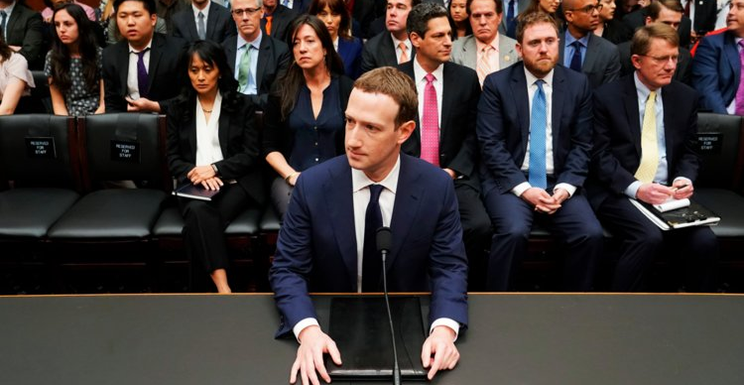


Question: How does Facebook make money?
By selling technology and services.
By selling data about you to other companies.
Through its apps (e.g. WhatsApp, Instagram)
By selling advertising.

Slide 6
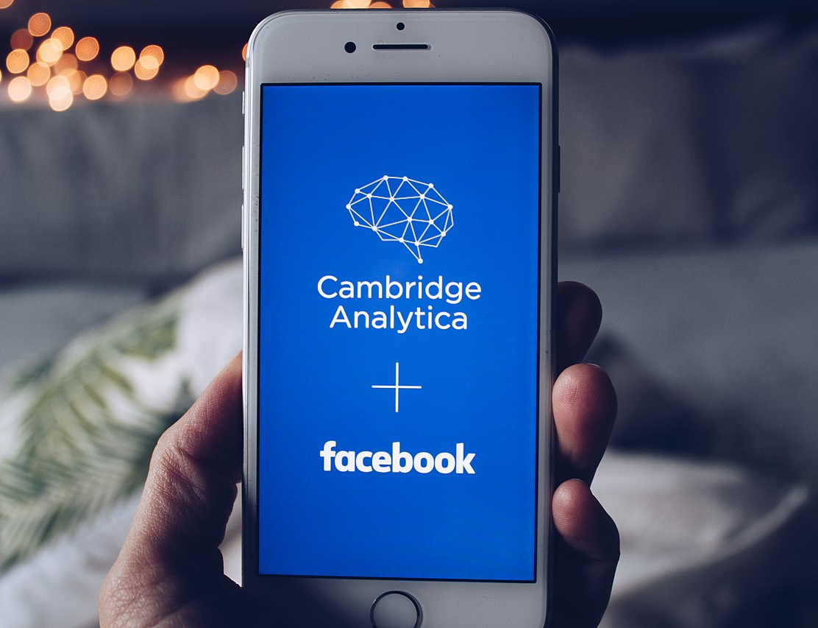
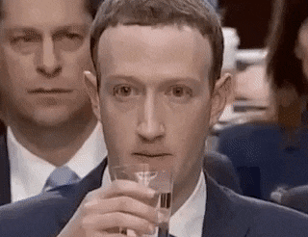
CAMBRIDGE ANALYTICA
Many remember the Cambridge Analytica scandal, which misused Facebook data.
Hundreds of thousands of participants participated in an “academic survey”
The data was used for political campaigns
As a result, political campaigns were able to conduct extremely targeted advertising.
Notes:
Image reference:
Shopcatalog (7 December 2018). Cambridge Analytica and Facebook. https://commons.wikimedia.org/wiki/File:Cambridge_Analytica_and_Facebook.jpg

Slide 7


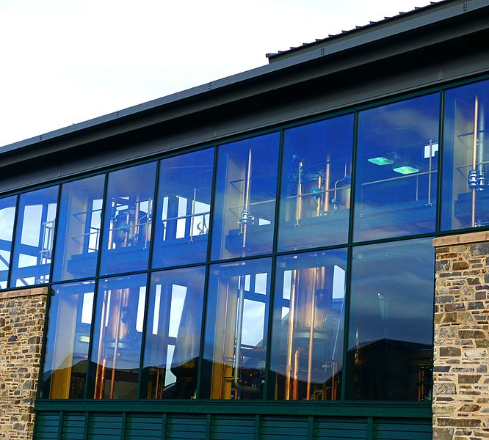
PRINCIPLES FOR ETHICAL SOCIAL DATA RESEARCH
The Cambridge Analytica scandal outlined (at least) three clear principles for conducting ethical social media research.
Consent
People must agree to the terms of the use.
Privacy
Users must control their identifying data.
Transparency
The methods must be outlined publicly.
Notes:
Picture attributions:
Rawpixel (9 November 2018). Business people shaking hands in agreement. https://www.flickr.com/photos/byrawpixel/43972155520
Hippopx (11 June 2017). Black car steering wheel. https://www.hippopx.com/en/black-car-steering-wheel-woman-drive-driver-314667

Slide 8
WHY CONTINUE SOCIAL MEDIA RESEARCH?
Yet, in spit of this, there are great reasons for continuing social media marketing research, specifically for charities:
It is playing an increasingly important role in our social lives.⁴
Charities have an ongoing need do more with the same.
We can hold social media companies (and others) accountable.⁵
Social media companies are data silos. Social media marketing research promises to keep them accountable and improve charities’ prospecting processes.
Notes:
4. Kane, G. C., Alavi, M., Labianca, G., & Borgatti, S. P. (2014). What’s different about social media networks? A framework and research agenda. MIS quarterly, 38(1), 275-304.
5. Medina Serrano, J. C., Papakyriakopoulos, O., & Hegelich, S. (2020, July). Exploring Political Ad Libraries for Online Advertising Transparency: Lessons from Germany and the 2019 European Elections. In International Conference on Social Media and Society (pp. 111-121).

Slide 9
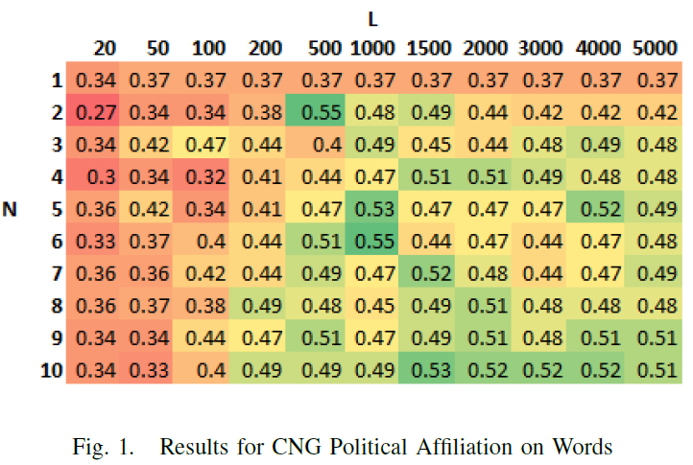
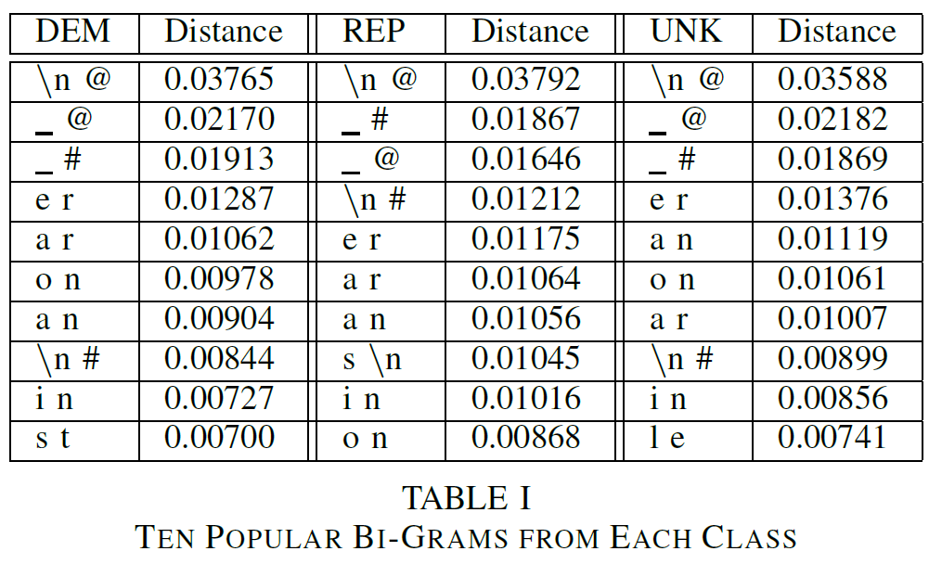
1. POLITICAL DONATIONS
We studied 219 Twitter users from Missouri in 2015 who self-identified a political donation.⁶
We invested profiles, Tweet aggregates
We applied character and word n-gram transformations to the data.
Classification was performed using trees, SVM, Naïve Bayes and CNG techniques.⁷
The result: the CNG identified political affiliation with 16% over baseline; NB identified donations with 17% using profiles.
Notes:
6. Conrad, C., & Kešelj, V. (2016, August). Predicting Political Donations Using Twitter Hashtags and Character N-Grams. In 2016 IEEE 18th Conference on Business Informatics (CBI) (Vol. 2, pp. 1-7). IEEE.
7. Kešelj, V., Peng, F., Cercone, N., & Thomas, C. (2003, August). N-gram-based author profiles for authorship attribution. In Proceedings of the conference pacific association for computational linguistics, PACLING (Vol. 3, pp. 255-264).
Image:
Beebe, E, Bolt, C, and Sarnak, R. (2 Nov 2020). Hwo could the 2020 election reshape elections in the future? https://www.waer.org/post/how-could-2020-election-reshape-elections-future

Slide 10
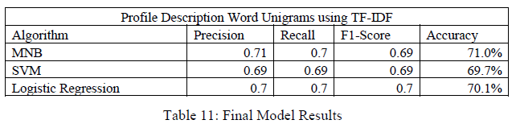
2. CHARITABLE GIVING
In 2019, we studied 4000 donors to a cause who consented to donor research.
Profile descriptions and Tweet profiles
We applied n-gram transforms, TF-IDF
Standard LogReg, SVM, and Naïve Bayes
The best model is described in Table 11:
Key findings:
Donors exhibit identifiable Twitter signals.
Profile descriptions carry information.
Word unigrams identified donors from non-donors.
We can eventually generate:
Better recommendations.
Insights about prospects.
Notes:
8. Calix Woc, Carlos J. (2020). Psychographic Profiling of Charitable Donations Using Twitter Data and Machine Learning Techniques (Master’s Research Project).

Slide 11
TOWARDS AN OPEN RESEARCH PROGRAMME
To do this ethically, this research must:
Be consensual
Give people control over their data (e.g. withdraw their data)
Be transparent
An open research programme can achieve this vision!
Transparent and ethical data collection
Open access publications
Publicly available scripts for AI research

Slide 12


THANK YOU!
If you are interested in continuing this conversation, don’t hesitate to reach out.
Colin.Conrad@dal.ca
@cd_conrad
You can find the references cited in the presentation notes.

